Slide 1

Spring 2026
Student Athlete/Parent
Meeting

Slide 2
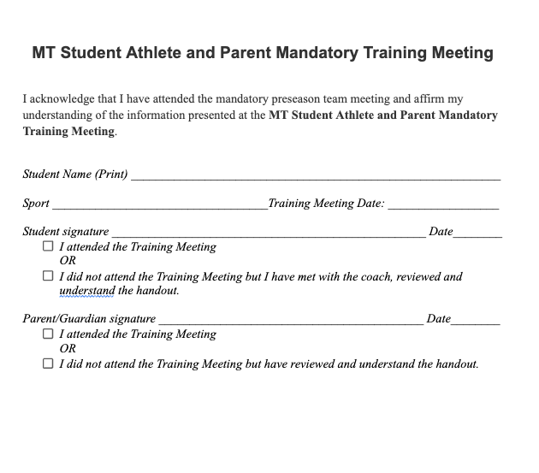
Be sure to pick up a sign off sheet and turn into your Coach by March 9th

Slide 3
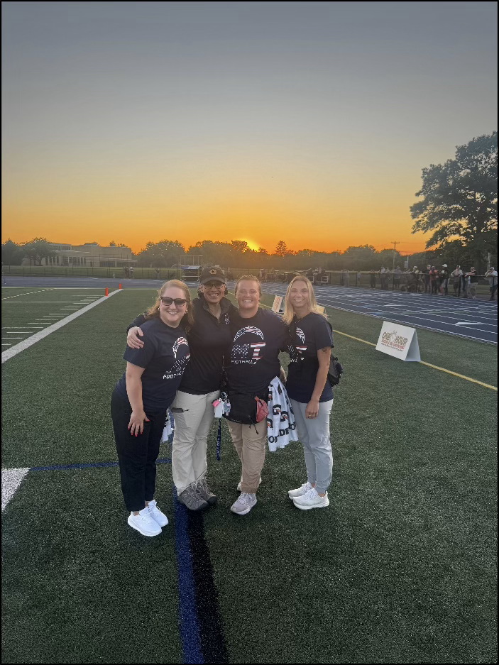
Presentation: Importance of Rest & Recovery
Kathryne J. Stabile, MD, MS
Orthopedic Surgery, Sports Medicine
Orthopedic Associates of Lancaster

Slide 4

Athletic Department Contacts/Communication
Athletic Department
  Athletic Director - Tim Hollenback: hollenti@mtwp.net
  Assistant Athletic Director - Amanda Rhinier: rhinieam@mtwp.net
  Athletic Administrative Assistant - Jill Gaissert : gaisseji@mtwp.net
  Head Athletic Trainer - Stephanie Haefele: haefelst@mtwp.net
Chain of Command
  Student-Athlete goes to coach with any issues.
  Student-Athlete and Parent set meeting with coach
  Student-Athlete, Parent, Coach, and AD meet together

Slide 5

Important Numbers & Contact Information
  Police: 911
  Safe to Say Tip Line: 1-844-723-2729 or www.safe2saypa.org
  Crisis Intervention of Lancaster: 717-394-2631
  National Suicide Prevention Lifeline: 988
  Crisis Text Line: Text HOME to 741741

Slide 6

Start Dates
Monday, March 2nd - High School Sports
Monday, March 9th - JH Track & Unified Track

Slide 7

Building Doors
  Never prop open, use a magnet, or “dog down” any doors
  Students should not handle/use keys nor swipe cards
  Student-Athletes should use the Arena entrance
Notes:
Make sure items are secure
Away contests - Make sure students secure their items no matter the location
Please clean up daily

Slide 8
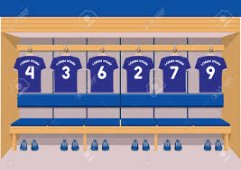
Locker Room Reminders:
  Appropriate locker room behavior is expected
    All school rules apply
  Cleaning up after oneself is expected
  School Board Policy #237 prohibits use of electronic devices in locker rooms and other changing areas at any time.
  If you have late arrival/early release, you will not be able to utilize the locker room without the supervision of a coach.
  Keep your belongings organized and respect the space of others.
  Focus on preparing for practice or games and supporting your teammates.
  Will not be unlocked unless a coach is present
Notes:
Keys/Swipe Cards are only issued to paid coaches
Athletic Trainers and Jill cannot give keys or swipe cards to student-athletes
Athletic Trainers are not responsible for opening locker rooms for student-athletes who arrive late to practice

Slide 9

Busing
  Students must return on the bus from away contests
  Coaches may approve parent/guardian pick up due to extenuating circumstances with prior approval and parental note
  Make sure student-athlete is visually passed off to the parent/guardian by a coach
  No music and food on the bus
  Appropriate bus behavior is expected - All school rules apply

Slide 10

School Closings/Postponements
  Wait for information to be communicated by the school/coach
  We will try to make a call on games/practice prior to noon each day.
  Any alternative practice plans will be communicated by the coach
  Next Available Date!
Notes:
Wait for information to be communicated by the athletic department or school prior to making a decision on canceling practices or games.

Slide 11

Hazing, Bullying, Physical Altercations:
  Covered by specific School Board Policies (Next Slide)
  Zero Tolerance
  Report any issues to Coach/AD/Principal ASAP
Notes:
Wait for information to be communicated by the athletic department or school prior to making a decision on canceling practices or games.

Slide 12

Township Specific Forms & Requirements
    Policy Sign Off Sheet
    School board policy 123 (Interscholastic Athletics)
    School board policy 218.4 (Extracurricular Activities)
    School board policy 227 (Controlled Substances)
    School board policy 247 (Hazing)
    School board policy 249 (Bullying/Cyberbullying)
    Overnight/Out of State Trips and Tours
    Extracurricular Activities and Interscholastic Sports Participation Code of Conduct

Slide 13

Athletic Trainers
Staff Information:
  Stephanie Haefele | Head Athletic Trainer | haefelst@mtwp.net
  Rebecca Covach | Associate Athletic Trainer - HS |covachre@mtwp.net
  Caitlyn Reed | Associate Athletic Trainer - MS | reedca@mtwp.net
The MTSD athletic trainers specialize in the prevention, evaluation, and rehabilitation of athletic injuries, as well as first aid and emergency medical care.When a Manheim Township student-athlete is injured during a practice or competition, the athletic trainer will evaluate the injury, determine the treatment plan, and refer the student-athlete to a physician if necessary.
  The athletic trainers can offer multiple in-house therapeutic treatments to student athletes. All treatments offered are at the discretion of the athletic trainer and will only be performed if deemed necessary
Notes:
All Booster Clubs have already provided the Athletic Department with an estimated budget of expenditures by August 31st.

Slide 14
Athletic Trainers
Medical Clearances & Documentation
  Any student athlete that seeks medical care from a physician during their athletic season must submit to the MTSD athletic trainer documentation regarding the diagnosis, prescribed treatment and the date the student-athlete may resume participation. Without this documentation, the athlete may not participate in practices or competitions.
After School Evaluations, School hours appointments
  Athletic training room is open for after school treatments and evaluations between 2:30 - 3:30pm.
  School hours appointments can only be arranged if the student is in a study hall
  Students may NOT be on the ineligible report in order to come to athletic training room during school hours.
Notes:
All Booster Clubs have already provided the Athletic Department with an estimated budget of expenditures by August 31st.

Slide 15

In the event of a possible head injury, the athlete will be removed immediately from play and evaluated
IF A STUDENT ATHLETE IS PLACED IN CONCUSSION PROTOCOL
BY THE ATHLETIC TRAINERS, IT CANNOT BE OVERTURNED, EVEN WITH A DOCTORS NOTE
After any head injury, AT’s contact the parent and notify them of diagnosis and next steps.
  Parents will be given the Concussion & Head Injury Information Packet - available on Healthy Roster under “resources”
School nurses will be notified for academic accommodations
Once a student athlete is diagnosed with a concussion, they must complete the return to play protocol in its entirety, even if a physician clears the student for immediate return to activity.
  Per the State Law Requirements: ACT 101
Concussion Protocol
Notes:
All Booster Clubs have already provided the Athletic Department with an estimated budget of expenditures by August 31st.

Slide 16
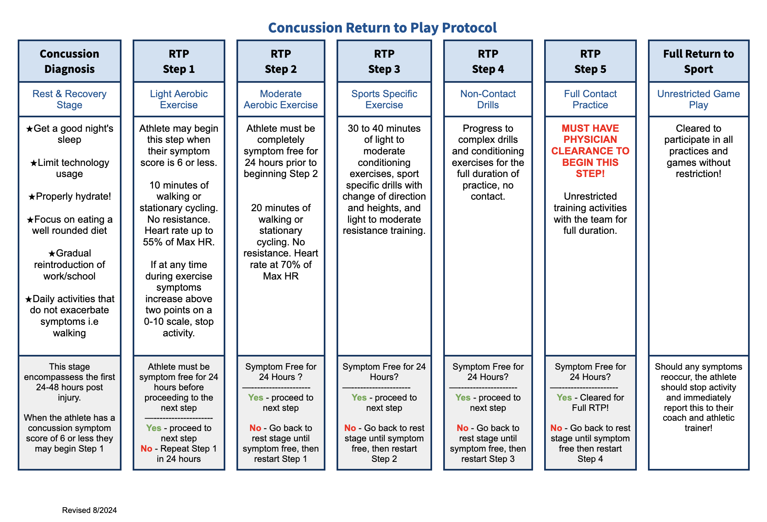
Notes:
All Booster Clubs have already provided the Athletic Department with an estimated budget of expenditures by August 31st.

Slide 17

Healthy Roster
All student athletes need are required to have a Healthy Roster account, with a parent/guardian having access to their portal
  PIAA Physical Document submission
  Check Healthy Roster Daily for injury updates
  Notifications need to be turned ON during season
    Missing PIAA document reminder
    Communication regarding injuries
    Direct messages with the athletic trainers
Athletic Trainers will still call parents when referrals are necessary
Notes:
All Booster Clubs have already provided the Athletic Department with an estimated budget of expenditures by August 31st.

Slide 18
PIAA Physicals
Cannot be completed any earlier than May 1st for the following school year.
Section 1, 2, 3, 4 are just demographics and signature pages for parent and athlete
Section 5 is a Health History form. All boxes must be checked and any "yes" needs to be described at the bottom of the form
Section 6 is the actual physical form, the one signed by their doctor. This form cannot be dated any earlier than 5/1/2025 for it to be accepted this school year.
Section 7 is the parent recertification form. The PIAA requires this form any time a physical was completed prior to 6 weeks from the start of the season. It only requires a parent and athlete signature and a few questions to be answered regarding if there have been any new injuries since the physical was completed.
Section 8 is the physician recertification form. We only require a section 8 form if they marked "yes" for any of the questions on section 7. This requires a doctor's signature and clearance stating that there has been a new injury since the physical but they are cleared now. We can accept a doctor's note in lieu of the actual section 8 form.

Slide 19
PIAA Physicals
Submitted on Healthy Roster
  Easiest when completed electronically via www.healthyroster.com instead of the app
Physicals submitted after the listed deadline risk not being reviewed and approved ahead of the first day of practices and therefore unable to participate on that day
Free PIAA physicals every summer at the high school:
  June 3rd & July 23rd 2026
  Sign ups will be released later in the spring

Slide 20

Cuts and Roster Management
Following tryouts, coaches will conduct individual meetings with each player to communicate team placement decisions.
      This could be in-person or via a letter.
      If letter method is used, students are encouraged to set a meeting with coach to discuss what they can improve on for future tryouts.
No public cut lists will be posted.
If a player is selected for a team, coaches will also briefly discuss roles on the team.
Notes:
- take the extra time early on to explain roles so you don’t have upset kids on your bench causing problems. These duties can be split up amongst all coaches in your program.

Slide 21

Academic Eligibility
Weekly Eligibility:
On any in-season Friday, if a student’s cumulative work from the beginning of the grading period falls below a passing level, for 2 or more classes, the student is ineligible the following Sunday through the next Saturday.
1st Week
  Student may practice, but can not play in a scheduled contest.
2nd Week
  Student may NOT practice OR play in a scheduled contest
  NOT permitted to attend practice even as an observer.
3rd Week
  Same as Week 2
4th Week
  The academically ineligible student is removed from the team.
**Weeks are counted cumulatively.
Each student-athletes academic progress is checked weekly.
Any student athlete reported failing 2 or more subjects, no matter what courses are involved, is ineligible for a one-week period, Sunday-Saturday
Coaches may receive a preliminary report midweek of any athletes failing at least one subject. Official eligibility reports are run every Friday and reported to coaches.

Slide 22
Academic Eligibility
Report Card Eligibility:
At the end of a marking period, a student athlete failing 2 or more subjects is ineligible for a period of 15 school days.
The athlete may practice but NOT participate in an event (i.e., scrimmage or game).
The 15 days begin on the first day report cards are issued.
After the 15th school day, the athlete’s academic progress is checked weekly.
This 15-day policy carries over to the next fall sports season if an athlete is failing two or more courses at the end of the school year.

Slide 23

Attendance Requirements
Daily report distributed to coaches.
Athletes failing to meet attendance requirements will be ineligible for practices, scrimmages, and games.
Students must attend a FULL SCHOOL DAY to be eligible for extracurricular events.
FULL SCHOOL DAY:
  Arrive no later than 30 minutes after the start of the school day
  Leaving within 30 minutes prior to the end of the school day
  Or provide parent/physician notes for late arrival/early dismissal
  Building administration may grant exceptions for exceptional circumstances

Slide 24

Sportsmanship
    MT Student-Athletes should represent our school and athletic department with the utmost respect and sportsmanship towards officials and opponents.
    Student-Athletes: If a player is ejected, he/she will sit out the PIAA imposed suspension and possibly face additional consequences per coach and/or administration.
    Parents/Families are expected to show similar sportsmanship from the sidelines.

Slide 25
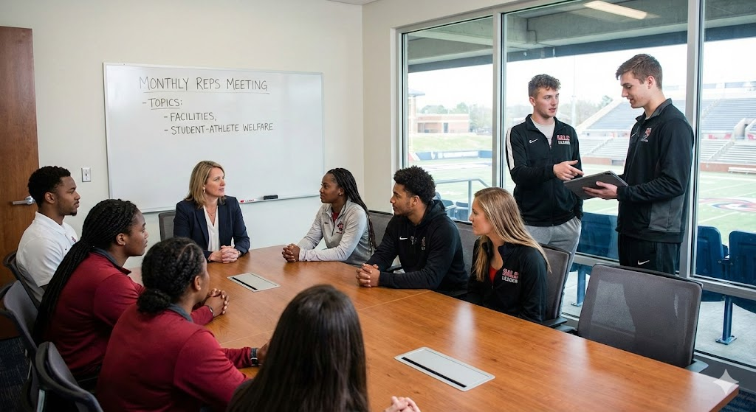
Student-Athlete Leadership Council
    Representatives from each team meets once a month with ADs
    Have your athlete connect with the SALC members
    New this year - selections from coaches and athletic department

Slide 26
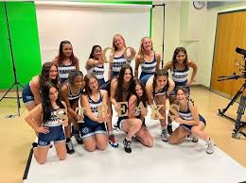

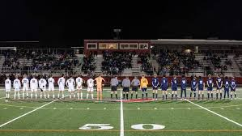
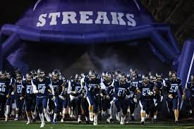
CORE VALUES
Grit
Optimism
Selflessness
Teamwork
Respect
Excellence
Accountability
Kindness
Service
GO STREAKS!

Slide 27

Example of What We Do in Leadership Council
Villanova Men’s Basketball - ATTITUDE

Slide 28

Social Media Information
    Instagram MTBlueStreaks
    Twitter X - MTSD_ATHLETICS
    Student-Athletes should recognize that the same sportsmanship and school discipline policies exist on social media. Disrespectful or vulgar posts from teams or individual student-athletes will be subject to team and school discipline.

Slide 29

Post - Season Information
  Overnight Trip Meeting
    Held with Coach, Athletic Director, Student-Athlete & Guardian
    Athlete and Parent/Guardian - Mandatory attendance
    Overnight Field Trip Agreement
    Overnight Trip Medications
Notes:
All Booster Clubs have already provided the Athletic Department with an estimated budget of expenditures by August 31st.

Slide 30
Be sure to pick up a sign off sheet and turn into your Coach by March 9th

Slide 31
Thank you!

