Slide 1


Slide 2
Township IB Prepares Students for to excel. MT IB students go on to
Major Research Universities
Selective Private and Ivy League Colleges
International Schools
U.S. Service Academies
Travels, Gap Years, Adventures
Notes:
2

Slide 3
Mission Statement
The International Baccalaureate aims to develop inquiring, knowledgeable and caring young people who help to create a better and more peaceful world through intercultural understanding and respect.
To this end the organization works with schools, governments and international organizations to develop challenging programmes of international education and rigorous assessment.
These programmes encourage students across the world to become active, compassionate and lifelong learners who understand that other people, with their differences, can also be right.

Slide 4
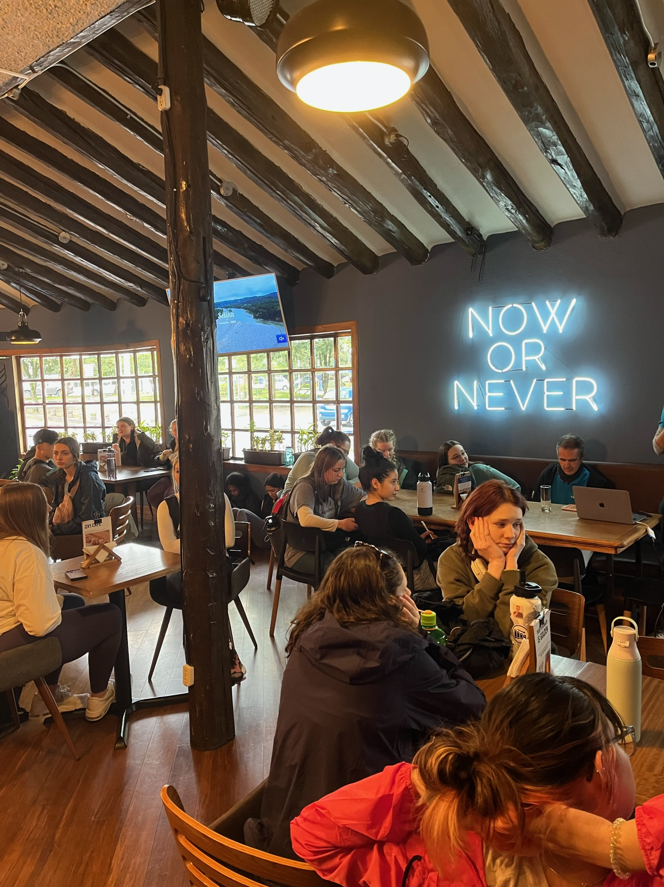
IB Learner Profile
The program aims to foster these traits
Inquirers
Knowledgeable
Thinkers
Communicators
Principled
Open-minded
Caring
Risk-takers
Balanced
Reflective

Slide 5
IB Program Hallmarks
is internationally focused
is interdisciplinary
is student-centered
is focused on skill development and student growth
Emphasizes critical thinking with a focus on written and verbal expression
emphasizes varied and valid assessment

Slide 6
Program Components
IB specified coursework in all disciplines
A Theory of Knowledge seminar course
Creativity, Activity, and Service participation
Composition of a research based Extended Essay
Learn more about the IB curriculum
at www.ibo.org

Slide 7
Preparation for College
IB graduates routinely report the program has prepared them exceptionally well for success in college and beyond.
IB grads frequently earn from nine credits, up to and including a full year of college credit for their work in high school.
Notes:
*

Slide 8
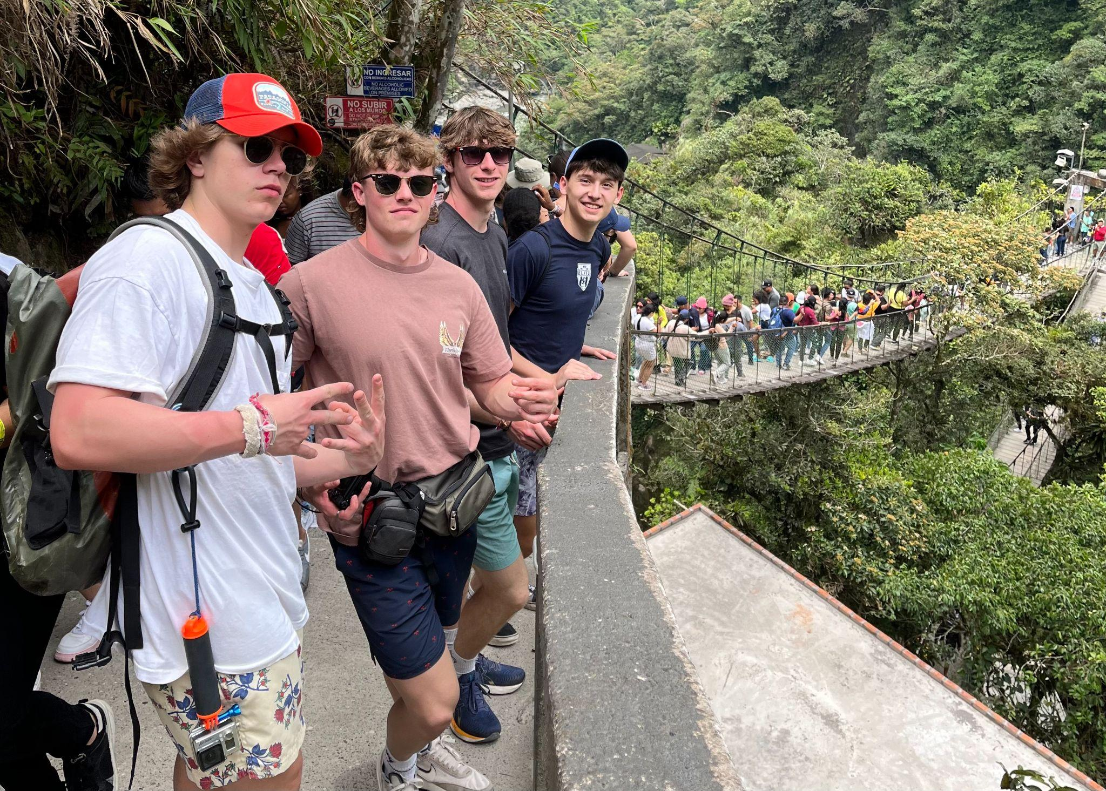
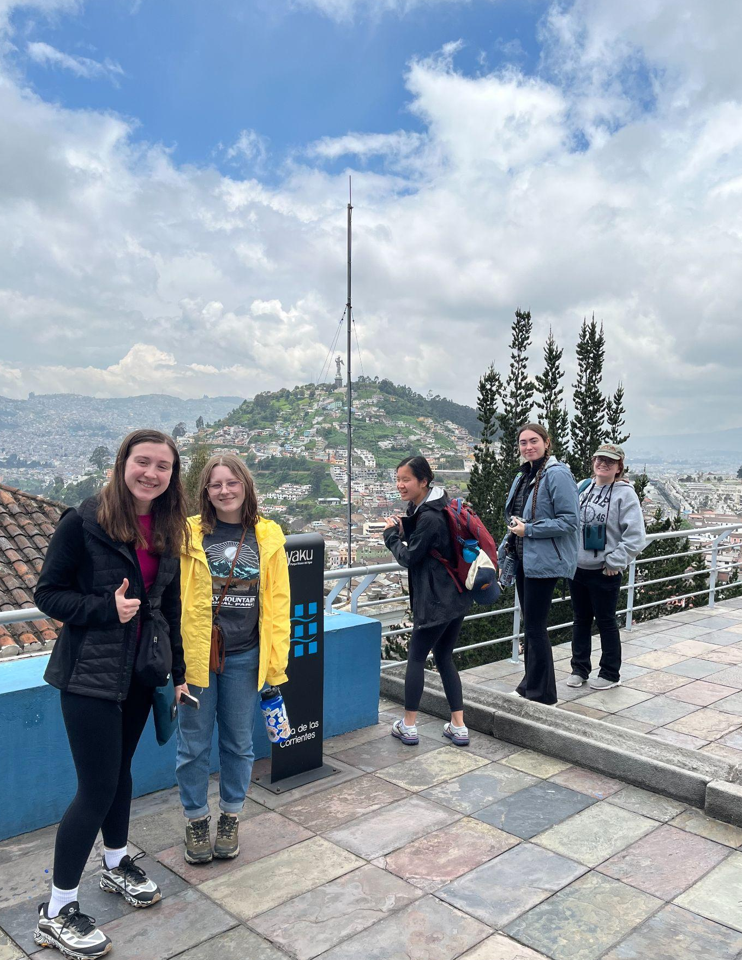
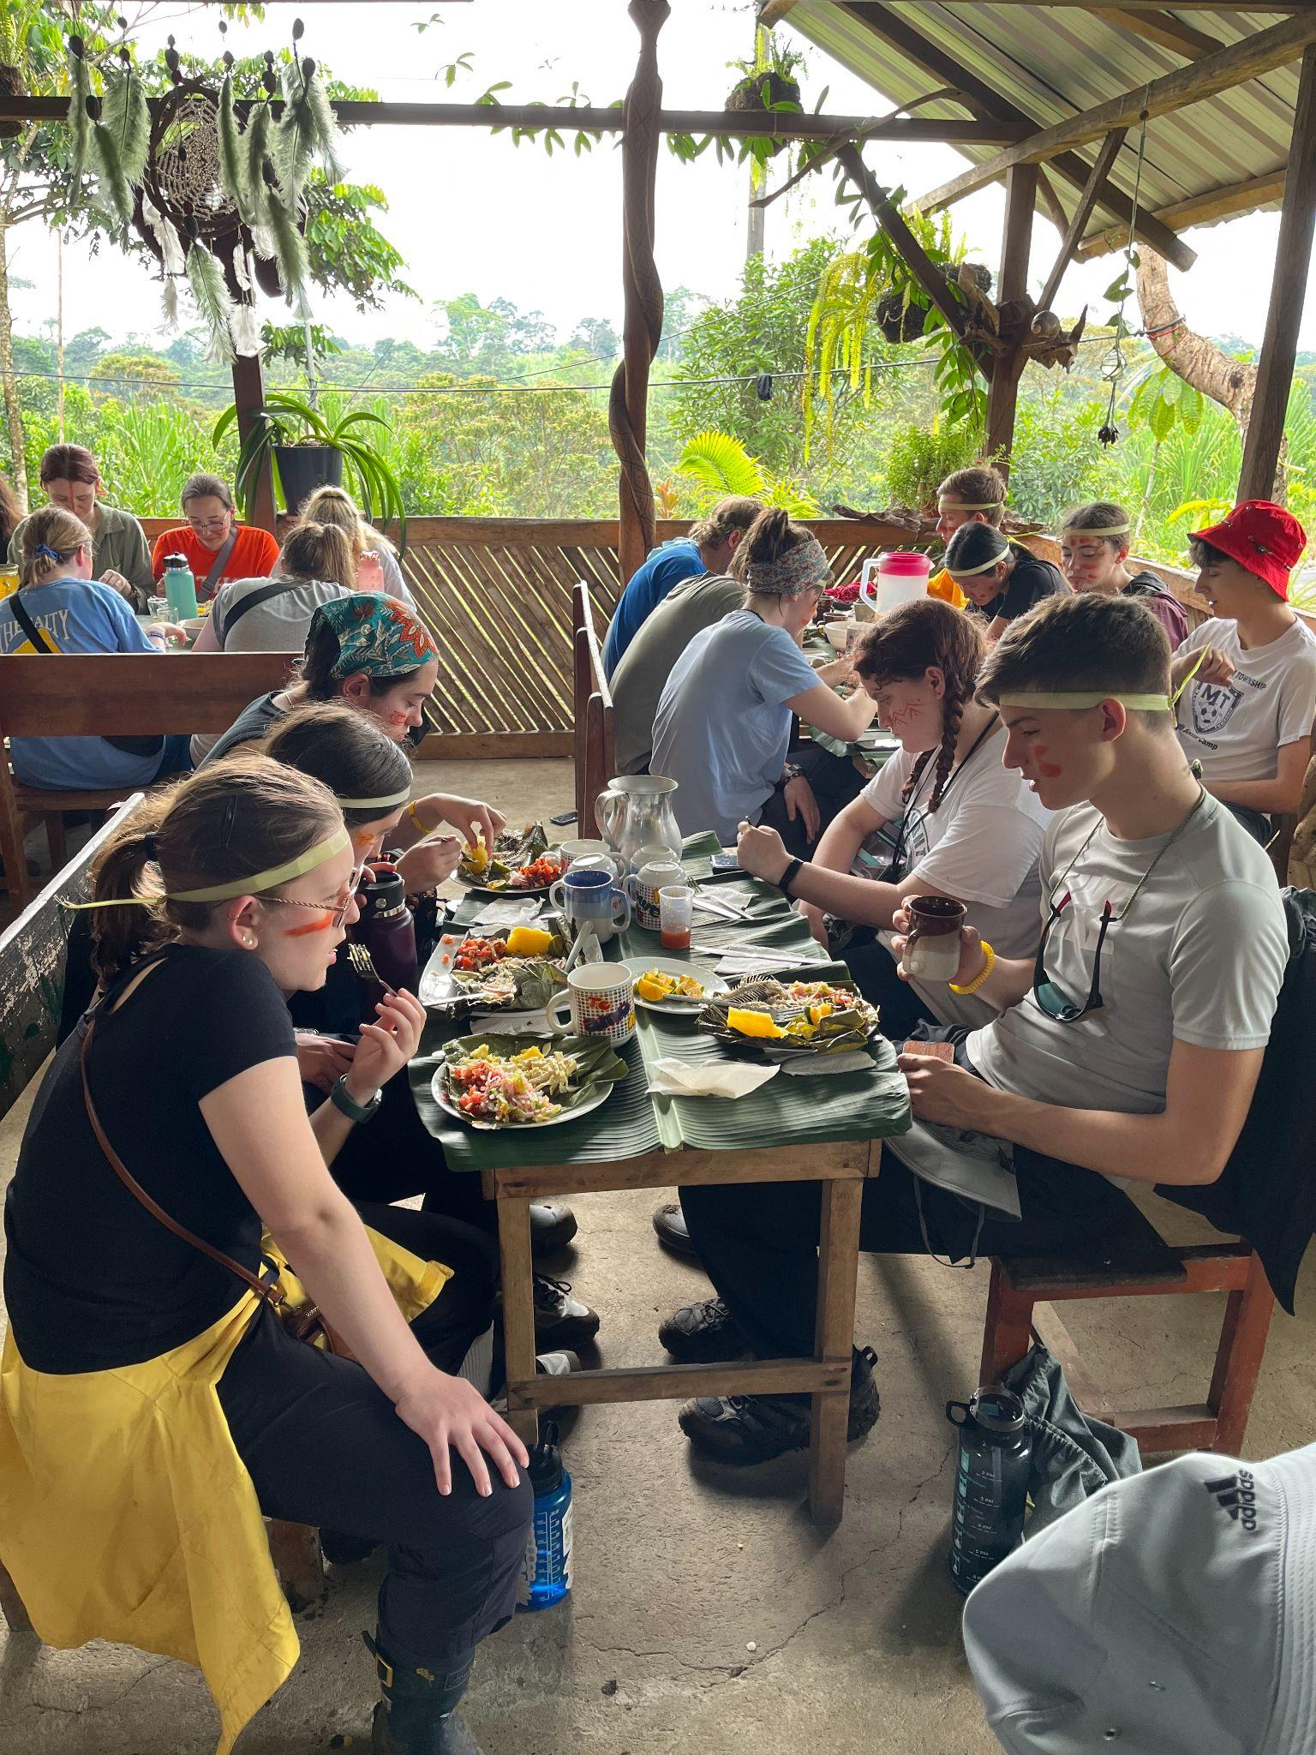
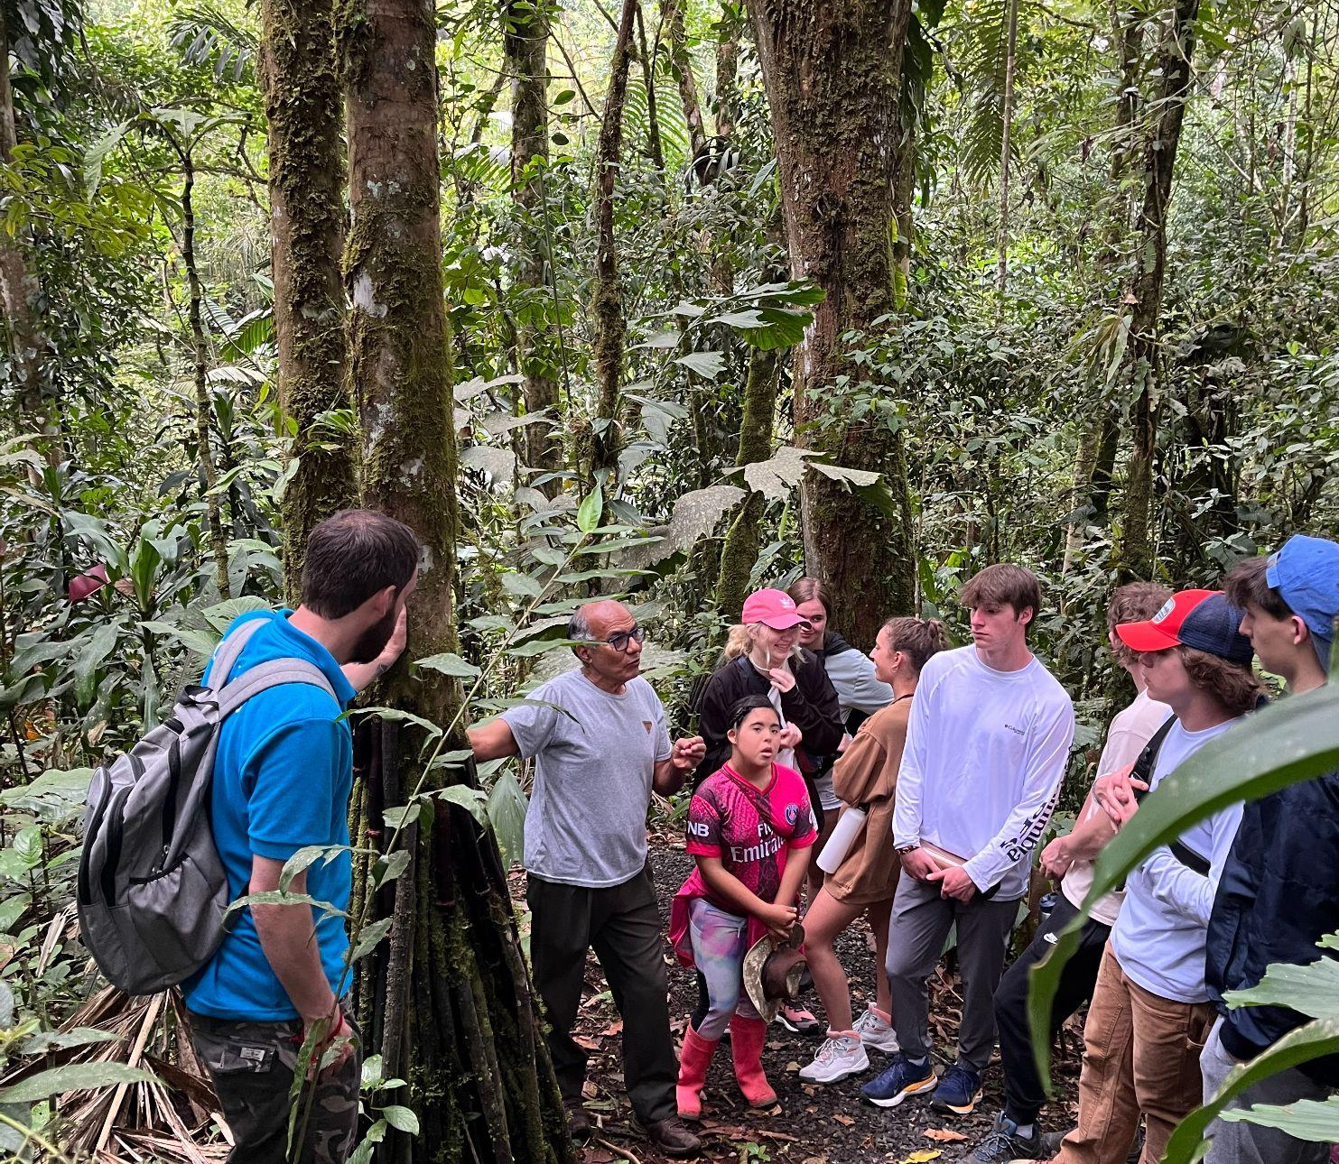
International Service Learning
MT has sponsored service learning trips to Dominican Republic, Nicaragua, and Ecuador.

Slide 9
Courses offered
Two-year courses
  English
  History of the Americas
  World Language (Spanish, French, or German)
  Mathematics
  Higher Level Sciences
  One-year courses
  Standard Level Sciences Economics
  Theory of Knowledge Visual Art
  Music
Notes:
*

Slide 10

A typical student schedule

Slide 11
IB offers motivated students a unique enrichment experience for their junior and senior years.
Applications due December 15 of sophomore year
Notes:
*

